Slide 1
Statistics
Vinay Mahajan
Novartis Pharmaceuticals,
Hyderabad, Mar 2010
Notes:
I booked my tickets, please find details attached. I will be there from the 24th (Wednesday night) until the 27th evening. Please book rooms from the 24th until the 27th.
Your Travel Details
Airline/Carrier
FareType
Departure
Arrival
Stops
Duration
Departing
Flight:
Kingfisher Red
DN-2440
▪Refundable
Fare rules
Hyderabad
Wed, 24 Mar
19:35
Bangalore
Wed, 24 Mar
21:05
NonStop
1h 30m
Redefining low cost flying. Experience world class service and earn King Miles every time you fly! .
Return
Flight:
Kingfisher Red
DN-2437
▪Refundable
Fare rules
Bangalore
Sat, 27 Mar
20:35
Hyderabad
Sat, 27 Mar
22:00
NonStop
1h 25m

Slide 2
Agenda
Basic statistics
Linear correlation
Linear regression
t-test, F-test, ANOVA
<number> | Presentation Title | Presenter Name | Date | Subject | Business Use Only

Slide 3

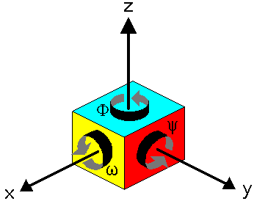
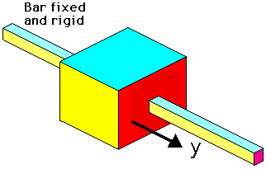
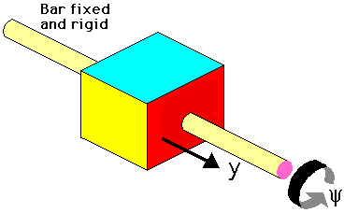
DF
Consider a rigid block that is free to move in 3 dimensional space. As shown in the diagram it may move without rotation in each of the three directions x, y and z. these are called the three degrees of translation.
The block may also rotate about each of the axes, these are called the three degrees of rotation.
Thus to uniquely define the position of the block in space we need to define six coordinates, three translation and three rotation.
It should be noted that each of the coordinates would be defined with respect to some fixed reference. The origin of the x. y and z axes would be a fixed position with respect to earth and the directions of the 3 axes would also be fixed.
It is possible to reduce the number of degrees of freedom of such a rigid block by introducing constraints
Degrees of Freedom
It is important to appreciate the concept of "degrees of freedom". The number of "degrees of freedom" that a vibrating system has will greatly affect how it vibrates. A simple definition of "degrees of freedom" is - the number of coordinates that it takes to uniquely specify the position of a system.
One degree of freedom
In this first case we have constrained the block to have only one degree of freedom by,
Using a rigid rod which is fixed to earth (not shown for clarity) Thus the block may move along the rod in the y direction only.
Also because the rod has a square section the block cannot rotate about the axis of the rod.
There is therefore only one degree of freedom. Knowing the position of the fixed and rigid rod we only need one coordinate - in this case the y coordinate - to uniquely specify the position of the block.
Two degrees of freedom
In this second case we have allowed the block a second degree of freedom by giving the rigid rod a circular section.
This means that the block may rotate about the axis of the rod. To uniquely define the position of the block now requires that we specify the position along the rod (the y coordinate) and also the rotation of the block about the rod (the y coordinate).
The block thus has two degrees of freedom.
Some skill is required in more complex systems to determine the number of degrees of freedom.
<number> | Presentation Title | Presenter Name | Date | Subject | Business Use Only
Notes:
Consider a rigid block that is free to move in 3 dimensional space. As shown in the diagram it may move without rotation in each of the three directions x, y and z. these are called the three degrees of translation.
The block may also rotate about each of the axes, these are called the three degrees of rotation.
Thus to uniquely define the position of the block in space we need to define six coordinates, three translation and three rotation.
It should be noted that each of the coordinates would be defined with respect to some fixed reference. The origin of the x. y and z axes would be a fixed position with respect to earth and the directions of the 3 axes would also be fixed.
It is possible to reduce the number of degrees of freedom of such a rigid block by introducing constraints
Degrees of Freedom
It is important to appreciate the concept of "degrees of freedom". The number of "degrees of freedom" that a vibrating system has will greatly affect how it vibrates.
A simple definition of "degrees of freedom" is - the number of coordinates that it takes to uniquely specify the position of a system.
One degree of freedom
In this first case we have constrained the block to have only one degree of freedom by,
Using a rigid rod which is fixed to earth (not shown for clarity) Thus the block may move along the rod in the y direction only.
Also because the rod has a square section the block cannot rotate about the axis of the rod.
There is therefore only one degree of freedom. Knowing the position of the fixed and rigid rod we only need one coordinate - in this case the y coordinate - to uniquely specify the position of the block.
Two degrees of freedom
In this second case we have allowed the block a second degree of freedom by giving the rigid rod a circular section.
This means that the block may rotate about the axis of the rod. To uniquely define the position of the block now requires that we specify the position along the rod (the y coordinate) and also the rotation of the block about the rod (the y coordinate).
The block thus has two degrees of freedom.
Some skill is required in more complex systems to determine the number of degrees of freedom.

Slide 4
Basic statistics
Statistics
Statistics Or How to make the numbers
say whatever you want.
<number> | Presentation Title | Presenter Name | Date | Subject | Business Use Only

Slide 5


Basic statistics
Statistics
“There are lies, damned lies, and statistics”
-- Disraeli
<number> | Presentation Title | Presenter Name | Date | Subject | Business Use Only

Slide 6


Basic statistics
Why use statistics?
Anecdotal evidence is unreliable
Why does the phone always ring when you’re in the shower?
<number> | Presentation Title | Presenter Name | Date | Subject | Business Use Only

Slide 7

Basic statistics
Why use statistics?
Determining the difference between chance and real effects
<number> | Presentation Title | Presenter Name | Date | Subject | Business Use Only

Slide 8
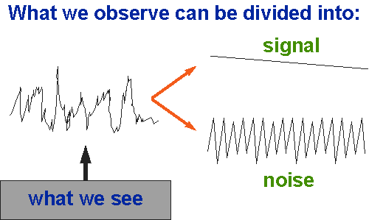

Basic statistics
Signal and Noise
Data = Signal + Noise
Signal = What we’re trying to measure
Noise = Error in our measurement
In research, we want the signal to be high relative to the noise.
If noise is random, then as the sample size increases, noise tends to cancel, leaving only signal.
<number> | Presentation Title | Presenter Name | Date | Subject | Business Use Only

Slide 9
Types of Variables: Overview
Basic statistics
Categorical
Treatment groups
Exposure groups
Disease status
Quantitative
binary
nominal
ordinal
discrete
continuous
2 categories +
more categories +
order matters +
numerical +
uninterrupted
Counts
Time
Age
Height
Blood counts
Speed of a car
Income
Time to event
Dead/alive
Treatment/placebo
Disease/no disease
Exposed/Unexposed
Blood type (O, A, B, AB)
Marital status
Occupation
Staging in cancer as I,II,III or IV
Birth order—1st, 2nd, 3rd, etc.
Letter grades (A, B, C, D, F)
Ratings on a scale from 1-5
Age in categories (10-20, 20-30, etc.)
<number> | Presentation Title | Presenter Name | Date | Subject | Business Use Only

Slide 10
Summary Measures: Overview
Basic statistics
Describing Data Numerically
Center and Location
Other Measures of Location
Variation
Range
Mean
Percentiles
Median
Interquartile Range
Quartiles
Mode
Variance
Weighted Mean
Standard Deviation
<number> | Presentation Title | Presenter Name | Date | Subject | Business Use Only

Slide 11
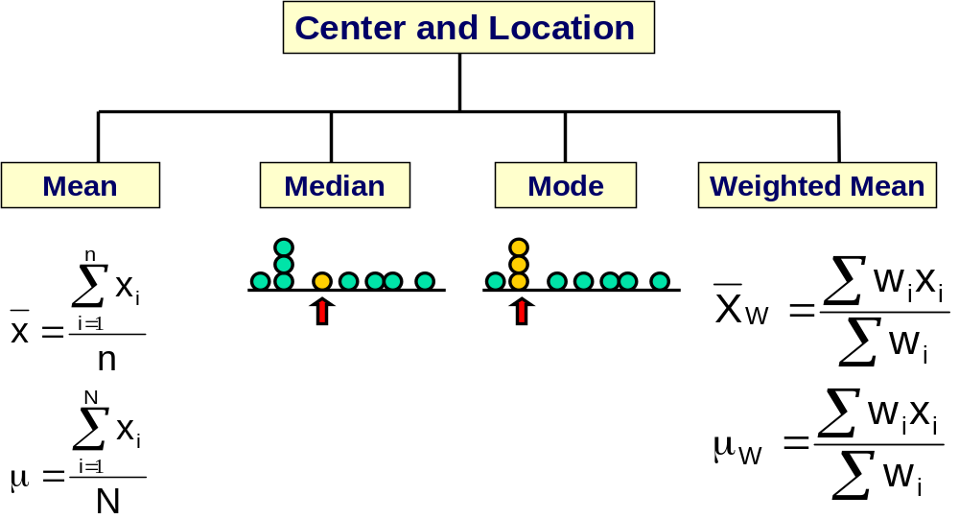
1. Measures of Central Tendency
Basic statistics
<number> | Presentation Title | Presenter Name | Date | Subject | Business Use Only

Slide 12
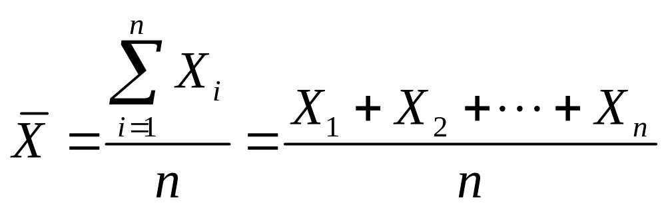
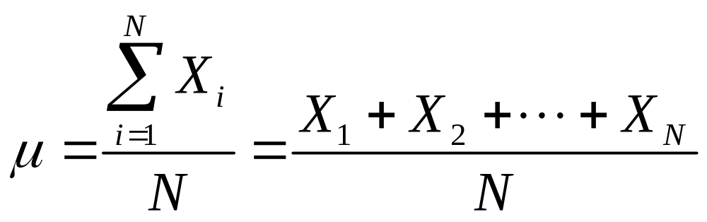
1.1. Mean (Arithmetic Mean)
Basic statistics
Mean (arithmetic mean) of data values
  Sample mean
  Population mean
Sample Size
Population Size
<number> | Presentation Title | Presenter Name | Date | Subject | Business Use Only

Slide 13
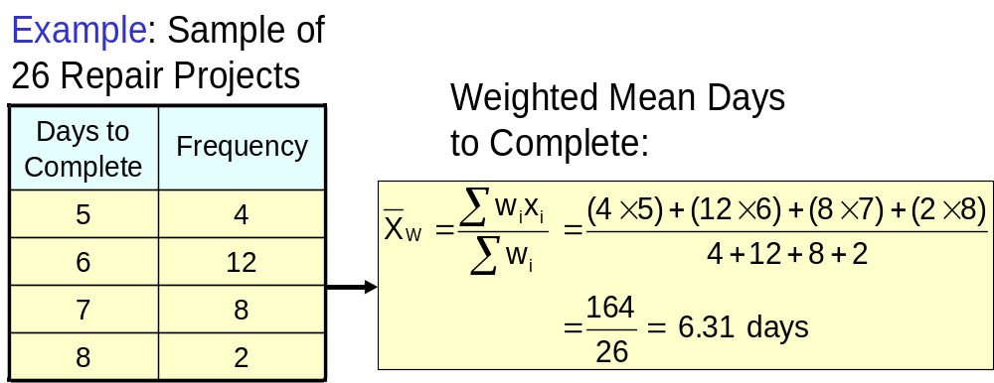
1.1 Mean (continued)
(Weighted Mean)
Basic statistics
Used when values are grouped by frequency or relative importance
<number> | Presentation Title | Presenter Name | Date | Subject | Business Use Only

Slide 14
1.2. Mode
Basic statistics
A measure of central tendency
Value that occurs most often
Not affected by extreme values
Used for either numerical or categorical data
There may be no mode or several modes
Mode = 9
No Mode
0 1 2 3 4 5 6
0 1 2 3 4 5 6 7 8 9 10 11 12 13 14
<number> | Presentation Title | Presenter Name | Date | Subject | Business Use Only

Slide 15
1.3. Median
Basic statistics
Robust measure of central tendency
Not affected by extreme values
In an ordered array, the median is the “middle” number
  If n or N is odd, the median is the middle number
  If n or N is even, the median is the average of the two middle numbers
0 1 2 3 4 5 6 7 8 9 10
0 1 2 3 4 5 6 7 8 9 10 12 14
Median = 5
Median = 5
<number> | Presentation Title | Presenter Name | Date | Subject | Business Use Only

Slide 16
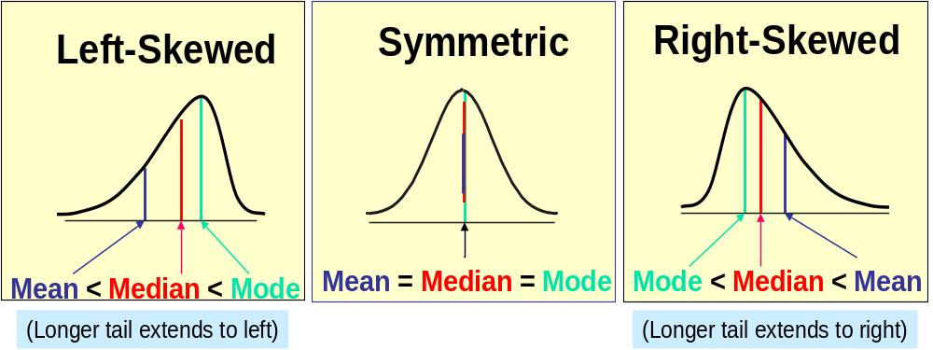
1.4. Shape of a Distribution
Basic statistics
Describes how data is distributed
Symmetric or skewed
<number> | Presentation Title | Presenter Name | Date | Subject | Business Use Only

Slide 17
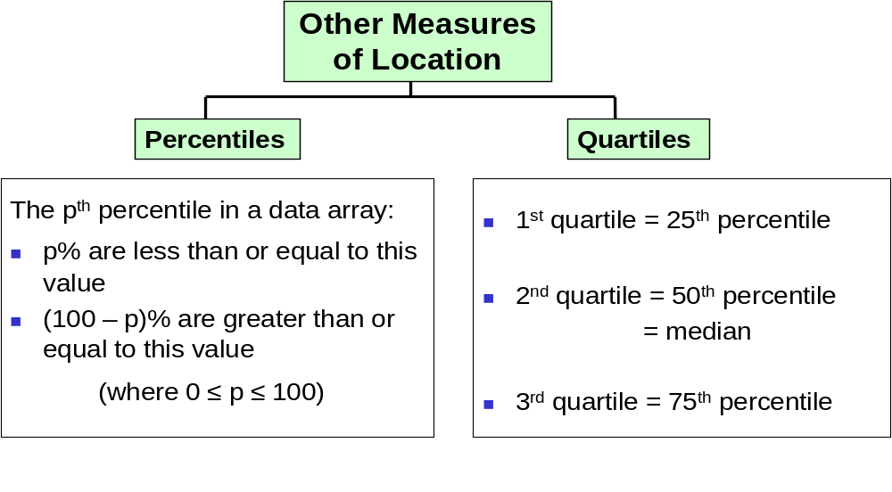
2. Other Location Measures
Basic statistics
<number> | Presentation Title | Presenter Name | Date | Subject | Business Use Only

Slide 18
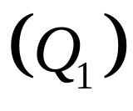
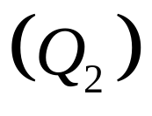
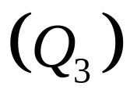
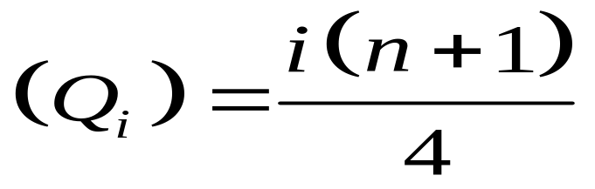
2.1. Quartiles
Basic statistics
Split Ordered Data into 4 Quarters
Position of ith Quartile
25%
25%
25%
25%
<number> | Presentation Title | Presenter Name | Date | Subject | Business Use Only

Slide 19
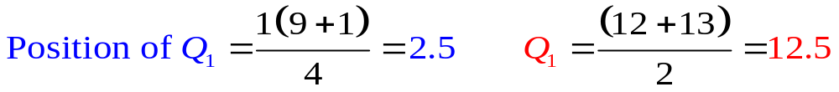

2.1. Quartiles (continued)
Basic statistics
Data in Ordered Array: 11 12 13 16 16 17 17 18 21
= Median = 16
Q3
= 17,5
<number> | Presentation Title | Presenter Name | Date | Subject | Business Use Only

Slide 20
2.2. Box-and-Whisker Plot
Basic statistics
Graphical Display of Data Using 5-Number Summary:
X
Q
Median
Q
X
smallest
1
3
largest
4
6
8
10
12
<number> | Presentation Title | Presenter Name | Date | Subject | Business Use Only

Slide 21



2.3. Distribution Shape and
Box-and-Whisker Plot
Basic statistics
Left-Skewed
Symmetric
Right-Skewed
<number> | Presentation Title | Presenter Name | Date | Subject | Business Use Only

Slide 22
3. Measures of Variation
Basic statistics
Variation
Variance
Standard Deviation
Coefficient of Variation
Range
Population
Variance
Population
Standard
Deviation
Sample
Variance
Sample
Standard
Deviation
Interquartile Range
<number> | Presentation Title | Presenter Name | Date | Subject | Business Use Only

Slide 23

3.1. Range
Basic statistics
Measure of variation
Difference between the largest and the smallest observations:
Ignore the way in which data are distributed
Range = 12 - 7 = 5
Range = 12 - 7 = 5
7 8 9 10 11 12
7 8 9 10 11 12
<number> | Presentation Title | Presenter Name | Date | Subject | Business Use Only

Slide 24
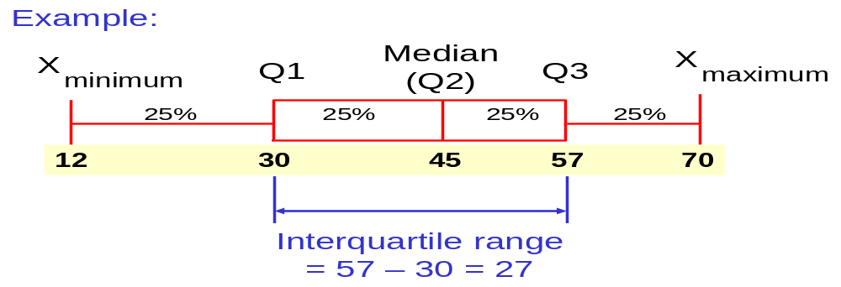
3.2. Interquartile Range
Basic statistics
Interquartile range = 3rd quartile – 1st quartile
Data in Ordered Array: 11 12 13 16 16 17 17 18 21
<number> | Presentation Title | Presenter Name | Date | Subject | Business Use Only

Slide 25
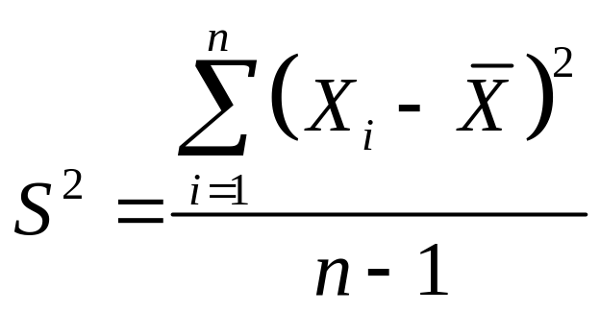
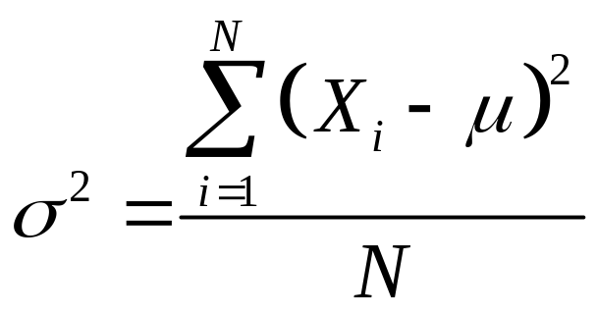
3.3. Variance
Basic statistics
Important measure of variation
Shows variation about the mean
  Sample variance:
  Population variance:
<number> | Presentation Title | Presenter Name | Date | Subject | Business Use Only

Slide 26
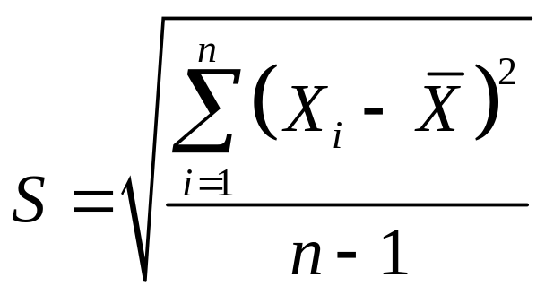
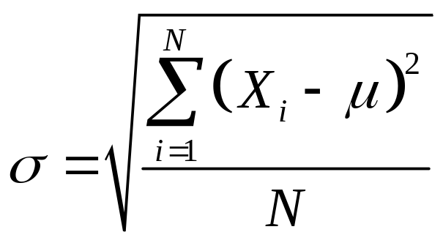
3.4. Standard Deviation
Basic statistics
Most important measure of variation
Shows variation about the mean
  Sample standard deviation:
  Population standard deviation:
<number> | Presentation Title | Presenter Name | Date | Subject | Business Use Only

Slide 27
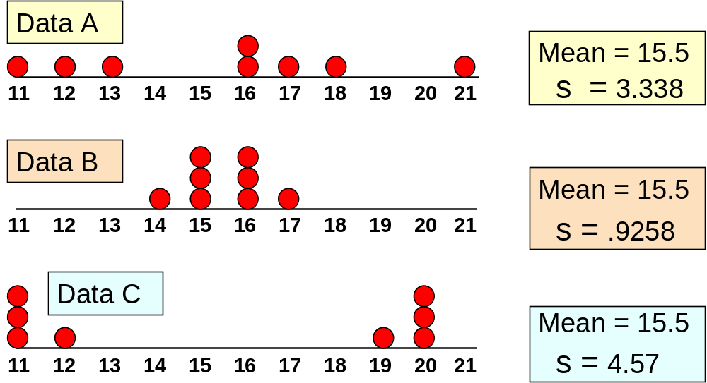
Comparing Standard Deviations
Basic statistics
<number> | Presentation Title | Presenter Name | Date | Subject | Business Use Only

Slide 28
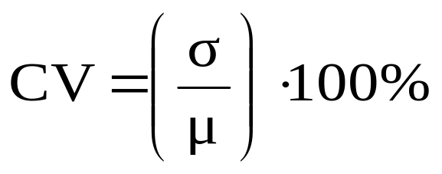
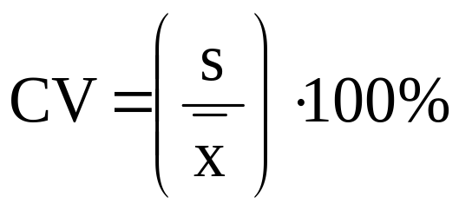
3.5. Coefficient of Variation
Basic statistics
Measure of Relative Dispersion
Always in %
Shows Variation Relative to Mean
Used to Compare 2 or More Groups
Formula:
Population Sample
<number> | Presentation Title | Presenter Name | Date | Subject | Business Use Only

Slide 29
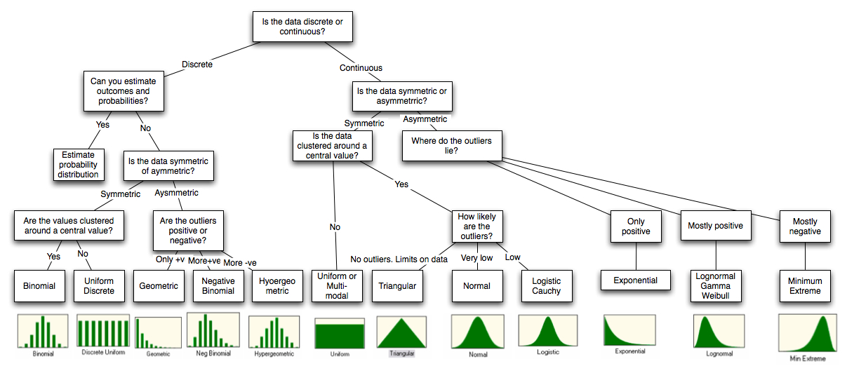
Basic statistics
Different distributions to explain the shape
<number> | Presentation Title | Presenter Name | Date | Subject | Business Use Only

Slide 30
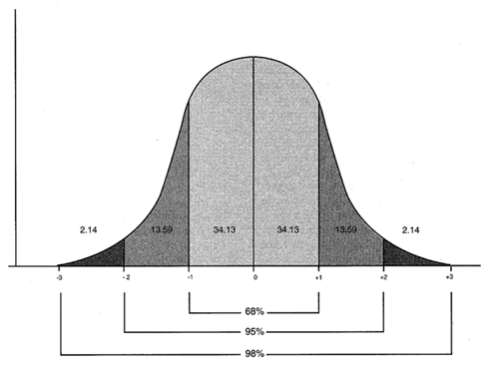
Basic statistics
The Normal Curve
Distributions
Raw data is almost never as well behaved as we would like it to be. Hence, fitting a statistical distribution to data is part art and part science, requiring compromises along the way.
The key to good data analysis is maintaining a balance between getting a good distributional fit and preserving ease of estimation, keeping in mind that the ultimate objective is that the analysis should lead to better decision.
In particular, you may decide to settle for a distribution that less completely fits the data over one that more completely fits it, simply because estimating the parameters may be easier to do with the former.
This may explain the overwhelming dependence on the normal distribution in practice, notwithstanding the fact that most data do not meet the criteria needed for the distribution to fit.
<number> | Presentation Title | Presenter Name | Date | Subject | Business Use Only

Slide 31
Basic statistics
Distributions: Central Limit Theorem
Example: from a population of five trees, we can only sample three. For the year 1842, the five trees had the following ring widths: 0.50 0.75 1.00 1.50 2.00
population mean = ? average of all sample means = ?
Any time you have a measure which is created by summing several individual trials of data (Signal + Noise) you will end up with a normal curve
<number> | Presentation Title | Presenter Name | Date | Subject | Business Use Only

Slide 32

Basic statistics
Distributions: Central Limit Theorem
Population mean = 1.15
(0.50+0.75+1.00)/3 = 0.75
(0.50+0.75+1.50)/3 = 0.92
(0.50+0.75+2.00)/3 = 1.08
(0.50+1.00+1.50)/3 = 1.00
(0.50+1.00+2.00)/3 = 1.17
(0.50+1.50+2.00)/3 = 1.33
(0.75+1.00+1.50)/3 = 1.08
(0.75+1.50+2.00)/3 = 1.42
(1.00+1.50+2.00)/3 = 1.50
average of all sample means = 1.14 (rounding error here)
0.50
0.75
1.00
1.50
2.00
<number> | Presentation Title | Presenter Name | Date | Subject | Business Use Only

Slide 33
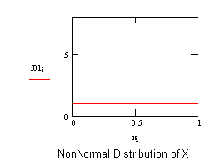
Basic statistics
Distributions: Central Limit Theorem
Sample size means everything! The more samples one collects, the closer one obtains information on the population itself!
Average conditions become more prominent.
The variability about the mean becomes less prominent.
Notice relationship with S/N ratio! Signal increases while noise decreases!
<number> | Presentation Title | Presenter Name | Date | Subject | Business Use Only

Slide 34

Basic statistics
The Right Statistic
A person wearing red is 129 times more likely to be gored by a charging bull!
But what is the base rate?
<number> | Presentation Title | Presenter Name | Date | Subject | Business Use Only

Slide 35
Basic statistics
The Right Statistic
98% of Americans have internet access available.
Consumer spending on prescription drugs has doubled since 1980.
10 times as many people die each year by plane crashes than train crashes.
During the Spanish-American war, the death rate for soldiers was 9 per 1000. The death rate for civilians in New York City was 16 per 1000.
<number> | Presentation Title | Presenter Name | Date | Subject | Business Use Only

Slide 36
Basic statistics
Funny Graphs
Fluffy O’s Cereal Gives a body Energy!!
10
??
5
1 minute 2 minutes
<number> | Presentation Title | Presenter Name | Date | Subject | Business Use Only

Slide 37
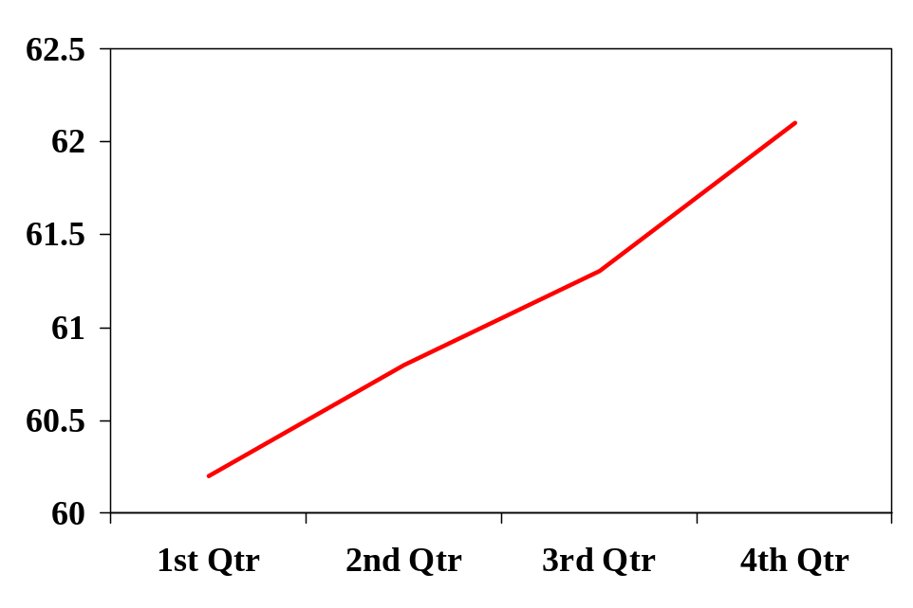
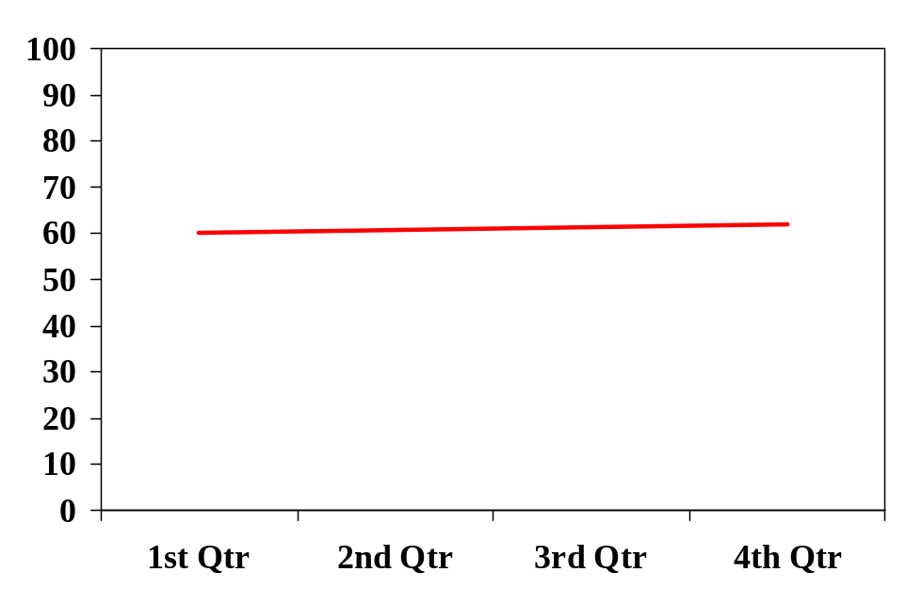
Basic statistics
Funny Graphs
Earnings
<number> | Presentation Title | Presenter Name | Date | Subject | Business Use Only

Slide 38
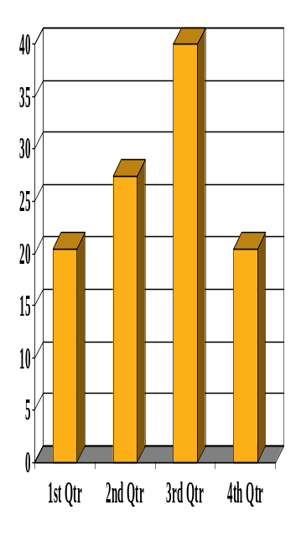

Basic statistics
Funny Graphs
Even when the scale is fine, graphs can still be deceptive
<number> | Presentation Title | Presenter Name | Date | Subject | Business Use Only

Slide 39

Basic statistics
Funny Graphs
As you can see, Bob earns substantially more than Joe
Joe’s Income
Bob’s Income
Is it really a two to one ratio that’s being displayed?
<number> | Presentation Title | Presenter Name | Date | Subject | Business Use Only

Slide 40
Basic statistics
Funny facts
1) University of Mumbai has the #1 program in psychology
2) I am the only (and therefore #1) student at University of Mumbai studying Decision Errors
Therefore: I am the top student studying Decision Errors in the country.
<number> | Presentation Title | Presenter Name | Date | Subject | Business Use Only

Slide 41

Basic statistics
Funny facts
On average Indian sleeps 8 hours a night
On average Indian sleeps 8.2 hours a night
On average Indian sleeps 8.2339 hours a night
<number> | Presentation Title | Presenter Name | Date | Subject | Business Use Only

Slide 42
Basic statistics
Points to keep in mind
Statistics are useful for figuring out random noise from real effects
2) Numbers are not absolute, and they can be easily manipulated
3) Always scrutinize data closely, and draw your own conclusions.
<number> | Presentation Title | Presenter Name | Date | Subject | Business Use Only

Slide 43
Agenda
<number> | Presentation Title | Presenter Name | Date | Subject | Business Use Only

Slide 44
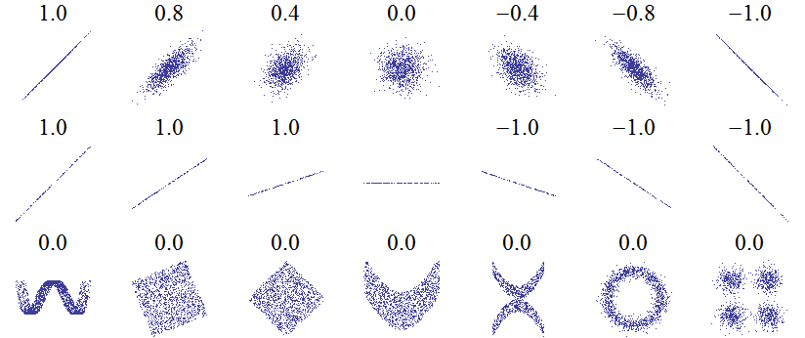
Linear correlation
What is this ?
Some rangoli ?
Some Microsoft word font ?
Some pictures from Hubble ?
<number> | Presentation Title | Presenter Name | Date | Subject | Business Use Only

Slide 45
Linear correlation
The Correlation
Correlation measures the strength/ predictability of a relationship between two variables.
<number> | Presentation Title | Presenter Name | Date | Subject | Business Use Only

Slide 46
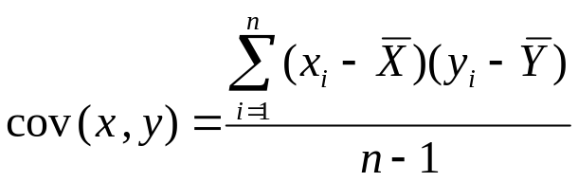
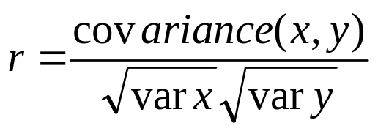
Interpreting Covariance
Linear correlation
cov(X,Y) > 0 X and Y are positively correlated
cov(X,Y) < 0 X and Y are inversely correlated
cov(X,Y) = 0 X and Y are independent
Pearson’s Correlation Coefficient is standardized covariance (unitless):
<number> | Presentation Title | Presenter Name | Date | Subject | Business Use Only

Slide 47
Correlation
Linear correlation
Unit-less
Ranges between –1 and 1
The closer to –1, the stronger the negative linear relationship
The closer to 1, the stronger the positive linear relationship
The closer to 0, the weaker any positive linear relationship
The two variables are treated as equals r_{xy} = r_{yx}
<number> | Presentation Title | Presenter Name | Date | Subject | Business Use Only

Slide 48
Scatter Plots of Data with Various Correlation coefficients
Linear correlation
Y
Y
Y
X
X
X
r = -1
r = -.6
r = 0
Y
Y
Y
X
X
X
r = +1
r = +.3
r = 0
<number> | Presentation Title | Presenter Name | Date | Subject | Business Use Only
Slide from: Statistics for Managers Using Microsoft® Excel 4th Edition, 2004 Prentice-Hall

Slide 49
Linear Correlation
Linear correlation
Linear relationships
Curvilinear relationships
Y
Y
X
X
Y
Y
X
X
<number> | Presentation Title | Presenter Name | Date | Subject | Business Use Only
Slide from: Statistics for Managers Using Microsoft® Excel 4th Edition, 2004 Prentice-Hall

Slide 50
Linear Correlation
Linear correlation
Strong relationships
Weak relationships
Y
Y
X
X
Y
Y
X
X
<number> | Presentation Title | Presenter Name | Date | Subject | Business Use Only
Slide from: Statistics for Managers Using Microsoft® Excel 4th Edition, 2004 Prentice-Hall

Slide 51
Linear Correlation
Linear correlation
No relationship
Y
X
Y
X
<number> | Presentation Title | Presenter Name | Date | Subject | Business Use Only
Slide from: Statistics for Managers Using Microsoft® Excel 4th Edition, 2004 Prentice-Hall

Slide 52
The Correlation
Linear correlation
Anscombe's Quartet: to demonstrate both the importance of graphing data before analyzing it
and the effect of outliers on statistical properties.
 | I |  | II |  | III |  | IV
 | x | y | x | y | x | y | x | y
 | 10 | 8.04 | 10 | 9.14 | 10 | 7.46 | 8 | 6.58
 | 8 | 6.95 | 8 | 8.14 | 8 | 6.77 | 8 | 5.76
 | 13 | 7.58 | 13 | 8.74 | 13 | 12.74 | 8 | 7.71
 | 9 | 8.81 | 9 | 8.77 | 9 | 7.11 | 8 | 8.84
 | 11 | 8.33 | 11 | 9.26 | 11 | 7.81 | 8 | 8.47
 | 14 | 9.96 | 14 | 8.1 | 14 | 8.84 | 8 | 7.04
 | 6 | 7.24 | 6 | 6.13 | 6 | 6.08 | 8 | 5.25
 | 4 | 4.26 | 4 | 3.1 | 4 | 5.39 | 19 | 12.5
 | 12 | 10.84 | 12 | 9.13 | 12 | 8.15 | 8 | 5.56
 | 7 | 4.82 | 7 | 7.26 | 7 | 6.42 | 8 | 7.91
 | 5 | 5.68 | 5 | 4.74 | 5 | 5.73 | 8 | 6.89
 | I | II | III | IV
Mean | 9 | 7.5 | 9 | 7.5 | 9 | 7.5 | 9 | 7.5
Var | 11 | 4.12 | 11 | 4.12 | 11 | 4.12 | 11 | 4.12
Cor | 0.816 |  | 0.816 |  | 0.816 |  | 0.816
Linear regression line in each case : y = 3 + 0.5x
<number> | Presentation Title | Presenter Name | Date | Subject | Business Use Only

Slide 53
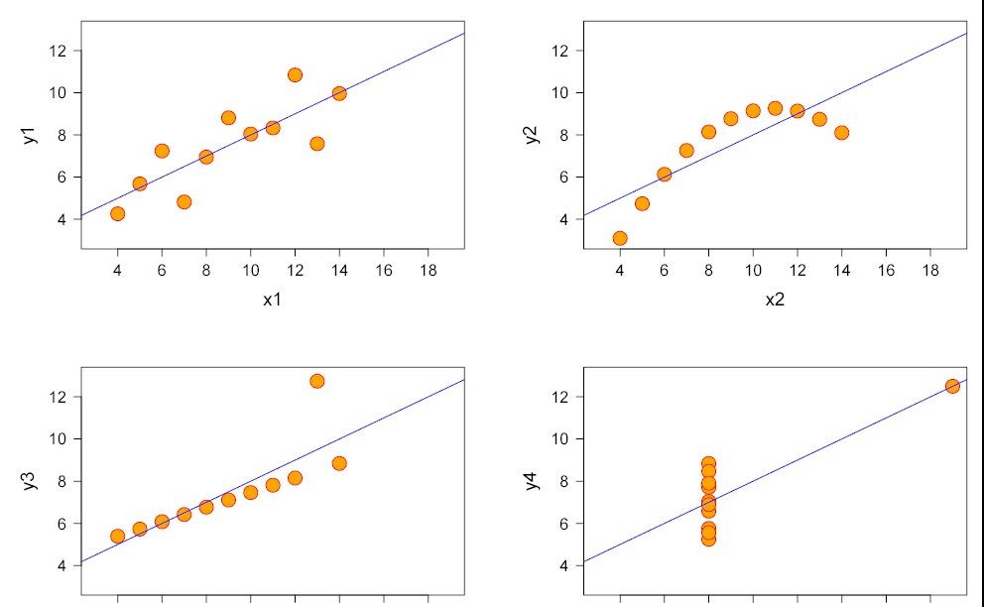
The Correlation
Linear correlation
Anscombe's Quartet: to demonstrate both the importance of graphing data before analyzing it
and the effect of outliers on statistical properties.
Normally distributed | Not distributed normally; while an obvious relationship between the two variables can be observed, it is not linear, and the Pearson correlation coefficient is not relevant
The distribution is linear, but with a different regression line, which is offset by the one outlier which exerts enough influence to alter the regression line and lower the correlation coefficient from 1 to 0.81 | One outlier is enough to produce a high correlation coefficient, even though the relationship between the two variables is not linear.
<number> | Presentation Title | Presenter Name | Date | Subject | Business Use Only

Slide 54
Linear correlation
The Correlation
These examples indicate that the correlation coefficient, as a summary statistic, cannot replace the individual examination of the data.
<number> | Presentation Title | Presenter Name | Date | Subject | Business Use Only

Slide 55
Linear correlation
The Correlation
Example 1 Sleeping with one's shoes on is strongly correlated with waking up with a headache. Therefore, sleeping with one's shoes on causes headache. This commits the correlation-implies-causation fallacy, as it prematurely concludes that sleeping with one's shoes on causes headache. A more plausible explanation is that both are caused by a third factor, in this case alcohol intoxication, which thereby gives rise to a correlation.
Example 2 Young children who sleep with the light on are much more likely to develop myopia in later life. Scientific example from a study at the University of Pennsylvania Medical Center. Published in the May 13, 1999 issue of Nature. However, a later study at The Ohio State University did not find that infants sleeping with the light on caused the development of myopia. It did find a strong link between parental myopia and the development of child myopia, also noting that myopic parents were more likely to leave a light on in their children's bedroom. In this case, the cause of both conditions is parental myopia.
Example 3 As ice cream sales increase, the rate of drowning deaths increases sharply. So, ice cream causes drowning. This example fails to recognize the importance of time in relationship to ice cream sales. Ice cream is sold during the summer months at a much greater rate, and it is during the summer months that people are more likely to engage in activities involving water, such as swimming. The increased drowning deaths are simply caused by more exposure to water based activities, not ice cream.
Coincidence: (1) Since the 1950s, both the atmospheric CO2 level & crime levels have increased sharply. Hence, atmospheric CO2 causes crime. (2) With a decrease in the number of pirates, there has been an increase in global warming over the same period. Therefore, global warming is caused by a lack of pirates.
<number> | Presentation Title | Presenter Name | Date | Subject | Business Use Only

Slide 56
Linear correlation
The Correlation
Correlation does not imply causation
<number> | Presentation Title | Presenter Name | Date | Subject | Business Use Only

Slide 57
Regression: Purpose of Linear Relationship
Linear regression
The primary purpose of Regression analysis is the development of an equation that can be used for predicting values on some Dependent Variable, Y, given Independent Variables, X, for all members of a population.
One of the most important functions of science is the description of natural phenomenon in terms of ‘functional relationships’ between variables. E.g. If one is given a temperature value in the ºC Scale (say X), then the corresponding value in the Fahrenheit Scale (say Y), can be calculated by the formula:
  Y = 32 + 1.8 X
  If the ºC temperature = 10, the Fahrenheit temperature =:
  Y = 32 + 1.8 (10) = 32 + 18 = 50
  Similarly, if the ºC = 20, the Fahrenheit temperature must be:
  Y = 32 + 1.8 (20) = 32 + 36 = 68
  We can plot this relationship on the usual rectangular system of coordinates.
<number> | Presentation Title | Presenter Name | Date | Subject | Business Use Only

Slide 58
What is “Linear”?
Linear regression
Remember this:
Y=a + bX ?
  X = Independent variable
  Y = Dependent variable
  b = Slope (angle and direction)
  a = Intercept (point at which line intersects Y axis)
    E.g. Y = 2X, A slope of 2 means that every 1-unit change in X yields a 2-unit change in Y.
b
a
<number> | Presentation Title | Presenter Name | Date | Subject | Business Use Only

Slide 59
Regression and Prediction
Linear regression
As a university admissions officer, what GPA would you predict for a student who earns a score of 650 on SAT-V ?
If the relationship between X and Y is not perfect, you should attach error to your prediction.
Correlation and Regression
Determining the Line of Best Fit or Regression Line using Least Squares Criterion.
<number> | Presentation Title | Presenter Name | Date | Subject | Business Use Only

Slide 60
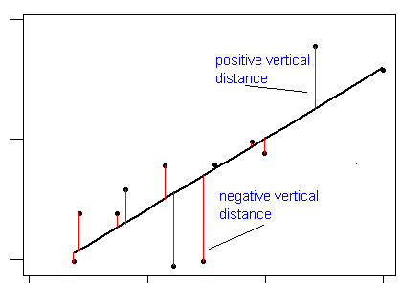
Selection of Regression Line
Linear regression
Residual or error of prediction = (Y –Y’)
  Positive or negative
Regression line, Y’ = a + bX, is chosen so that the sum of the squared prediction error for all cases, ∑(Y- Y’)², is as small as possible
<number> | Presentation Title | Presenter Name | Date | Subject | Business Use Only

Slide 61
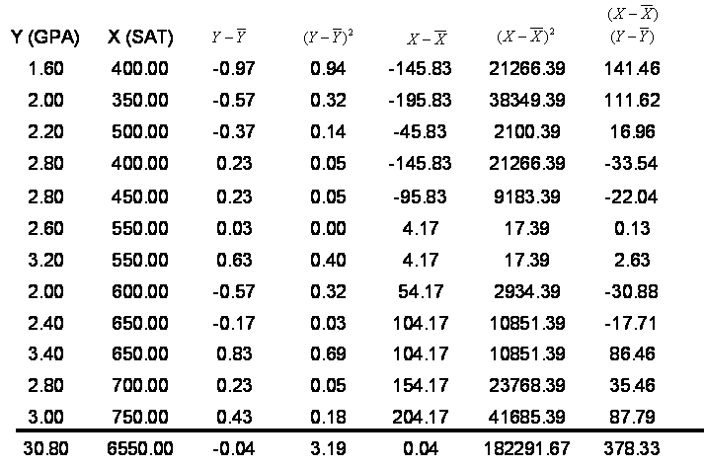
Calculation of Regression Line
Linear regression
Calculate
sum
<number> | Presentation Title | Presenter Name | Date | Subject | Business Use Only

Slide 62
Calculation of Regression Line
Linear regression
Continued
Calculate
deviation
from
average Y
<number> | Presentation Title | Presenter Name | Date | Subject | Business Use Only

Slide 63
Calculation of Regression Line
Linear regression
Continued
Calculate
deviation
from
average X
<number> | Presentation Title | Presenter Name | Date | Subject | Business Use Only

Slide 64
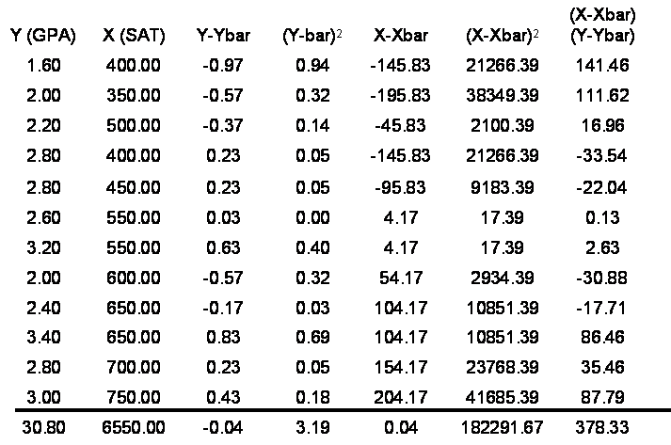






Calculation of Regression Line
Linear regression
Continued
Calculate
product of
deviation from
X and Y
<number> | Presentation Title | Presenter Name | Date | Subject | Business Use Only

Slide 65
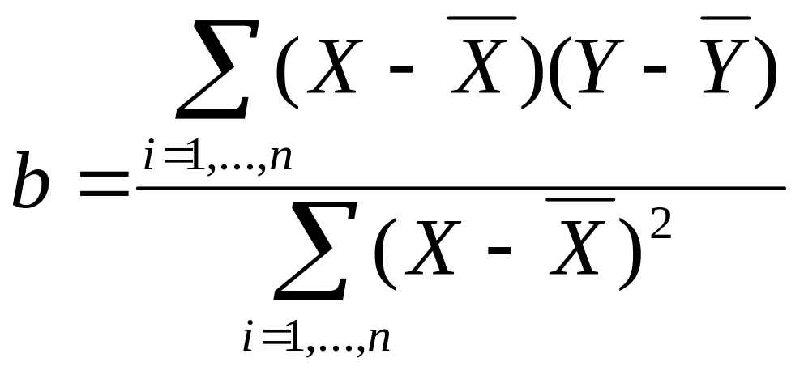
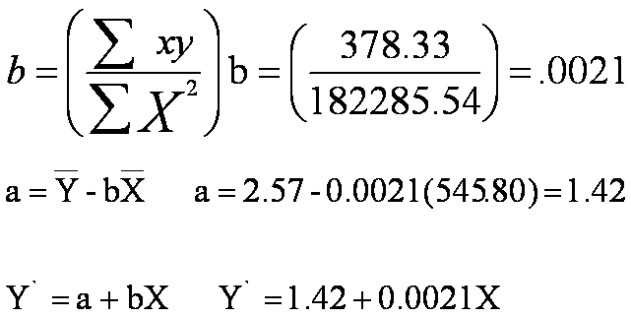
Calculation of Regression Line
Linear regression
Continued
<number> | Presentation Title | Presenter Name | Date | Subject | Business Use Only

Slide 66
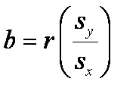
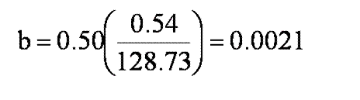
Calculation of Regression Line
Linear regression
Continued
Standard
Deviation of Y
Standard
Deviation of X
Correlation
of X & Y
<number> | Presentation Title | Presenter Name | Date | Subject | Business Use Only

Slide 67
Calculation of Regression Line
Linear regression
Continued
<number> | Presentation Title | Presenter Name | Date | Subject | Business Use Only

Slide 68
Calculation of Regression Line
Linear regression
Continued
a = 1.42
b = .0021
Y’ = 1.42 + .0021 X
<number> | Presentation Title | Presenter Name | Date | Subject | Business Use Only

Slide 69
Calculation of Predicted Values and Residuals
Linear regression
 | Y (GPA) | X (SAT) | Y’ | Y-Y’
 | 1.60 | 400.00 | 2.26 | -0.66
 | 2.00 | 350.00 | 2.16 | -0.16
 | 2.20 | 500.00 | 2.47 | -0.27
 | 2.80 | 400.00 | 2.26 | 0.54
 | 2.80 | 450.00 | 2.37 | 0.43
 | 2.60 | 550.00 | 2.58 | 0.02
 | 3.20 | 550.00 | 2.58 | 0.62
 | 2.00 | 600.00 | 2.68 | -0.68
 | 2.40 | 650.00 | 2.78 | -0.38
 | 3.40 | 650.00 | 2.78 | 0.62
 | 2.80 | 700.00 | 2.89 | -0.09
 | 3.00 | 750.00 | 2.99 | 0.01
Sum | 30.80 | 6550.00 | 30.80 | 0.00
Average | 2.57 | 545.83 | 2.57 | 0.00
Y’ = 1.42 + .0021 X
<number> | Presentation Title | Presenter Name | Date | Subject | Business Use Only

Slide 70
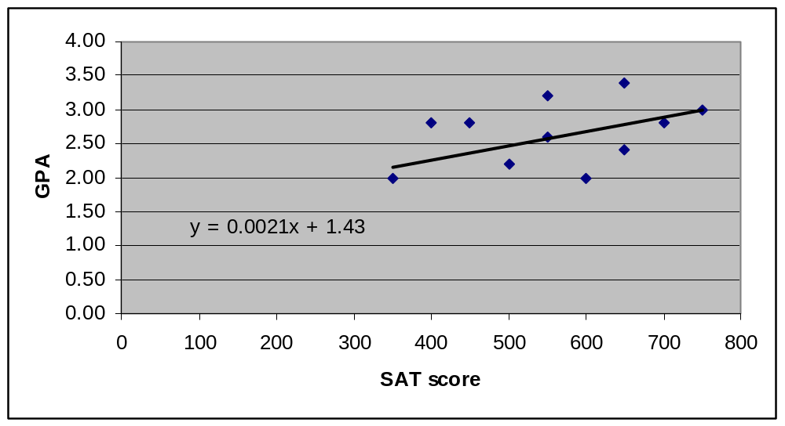
Plot of Data
Linear regression
<number> | Presentation Title | Presenter Name | Date | Subject | Business Use Only

Slide 71
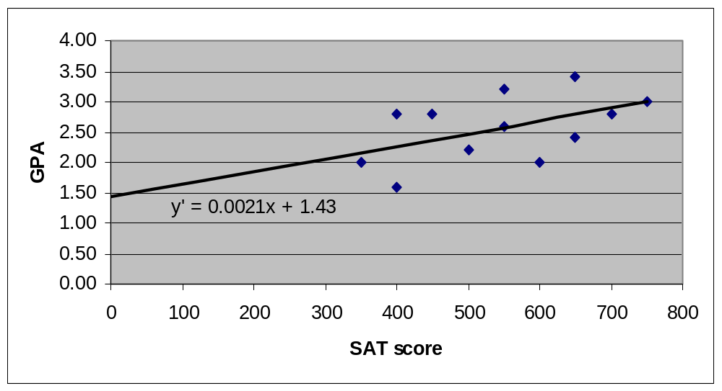
Plot of Data
Linear regression
Slope shows
change in Y
associated to
to change
in one unit of X
Intercept
Regression line shows
predicted values. Difference
between predicted & observed
is the residual
<number> | Presentation Title | Presenter Name | Date | Subject | Business Use Only

Slide 72
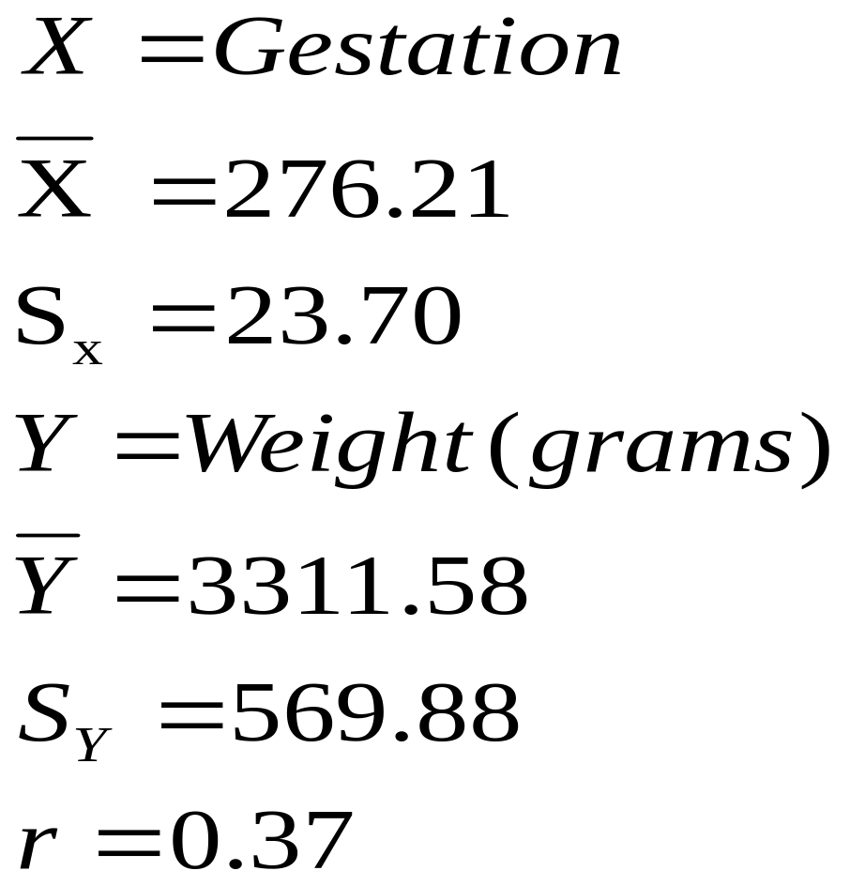
Calculation of Regression Line Using Standard Deviations
Linear regression
Predicted weight = 811 + 9 Gestation days
<number> | Presentation Title | Presenter Name | Date | Subject | Business Use Only

Slide 73
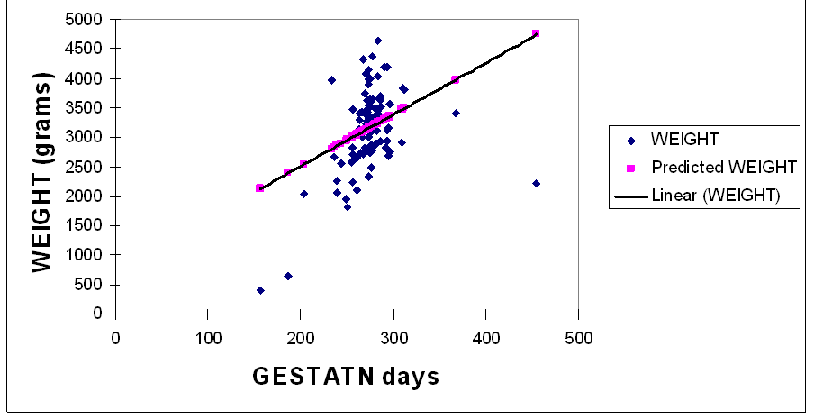
Relationship between Weight & Gestation Days
Linear regression
Predicted weight = 811 + 9 Gestation days
Regression equation: Y` = 811 + 9 X
Intercept
<number> | Presentation Title | Presenter Name | Date | Subject | Business Use Only

Slide 74
Predicting Weight from Gestation Days
Linear regression
If a baby’s gestation is… | Add Intercept | Plus Coefficient TIMES gestation | Predicted Weight
250 | 811 | 811 + 9* (250) | 3061
260 | 811 | 811 + 9* (260) | 3151
270 | 811 | 811+ 9* (270) | 3241
280 | 811 | 811 + 9* (280) | 3331
300 | 811 | 811 + 9* (300) | 3511
<number> | Presentation Title | Presenter Name | Date | Subject | Business Use Only

Slide 75
Sources of Variation
Linear regression
The sum of Squares of the Dependent Variable is partitioned into two components:
  One due to Regression (Explained)
  One due to Residual (Unexplained)
<number> | Presentation Title | Presenter Name | Date | Subject | Business Use Only
Notes:
Similarities between ANOVA and regression

Slide 76
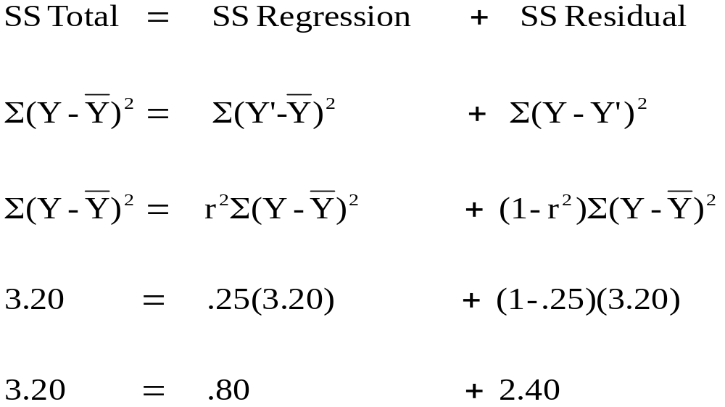
Partitioning of Sum of Squares
Linear regression
<number> | Presentation Title | Presenter Name | Date | Subject | Business Use Only
Notes:
Short cut

Slide 77
Testing Statistical Significance of Variance Explained
Linear regression
Source of variation | SS | df
Regression | 0.80 2.40 | 1 10
Residual
Total | 3.20 | 11
<number> | Presentation Title | Presenter Name | Date | Subject | Business Use Only

Slide 78
Testing Statistical Significance of Variance Explained
Continued
Linear regression
Source of variation | SS | df | MS
Regression | 0.80 2.40 | 1 10 | 0.80 0.24
Residual
Total | 3.20 | 11
<number> | Presentation Title | Presenter Name | Date | Subject | Business Use Only

Slide 79
Testing Statistical Significance
Continued
Linear regression
Source of variation | SS | df | MS | F | F_{α}
Regression | 0.80 2.40 | 1 10 | 0.80 0.24 | 3.33 | 4.90
Residual
Total | 3.20 | 11
Testing the proportion of variance due to regression
H₀ : R² = 0 Since the F< F_{α} fail to reject H_{o}
H_{a} : R² ≠ 0
<number> | Presentation Title | Presenter Name | Date | Subject | Business Use Only

Slide 80
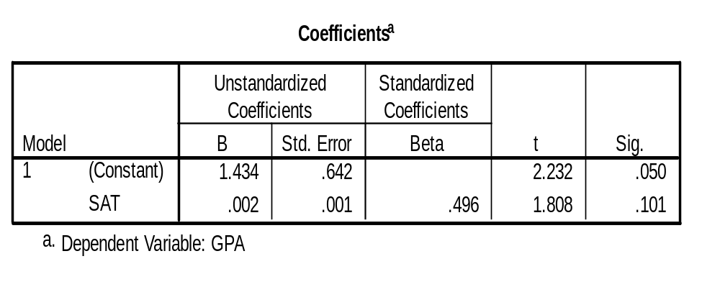
Testing Statistical Significance of Regression Coefficient
Linear regression
B. Testing the Regression Coefficient
H₀ : β = 0 Since the p> α Fail to reject H_{o}
H_{a} : β ≠ 0
<number> | Presentation Title | Presenter Name | Date | Subject | Business Use Only

Slide 81
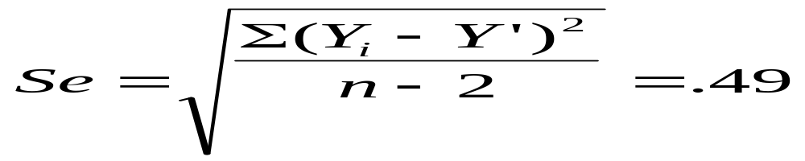
Standard Error of Estimate of Y Regressed on X
Linear regression
<number> | Presentation Title | Presenter Name | Date | Subject | Business Use Only

Slide 82
Interpretation of Standard Error of Estimate
Linear regression
The average amount of error in predicting GPA scores is 0.49.
The smaller the standard error of estimate, the more accurate the predictions are likely to be.
<number> | Presentation Title | Presenter Name | Date | Subject | Business Use Only

Slide 83
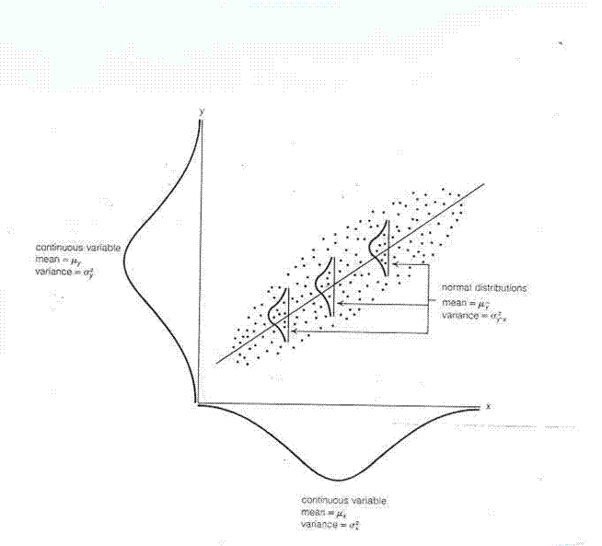
Assumptions
Linear regression
X and Y are normally distributed
<number> | Presentation Title | Presenter Name | Date | Subject | Business Use Only

Slide 84
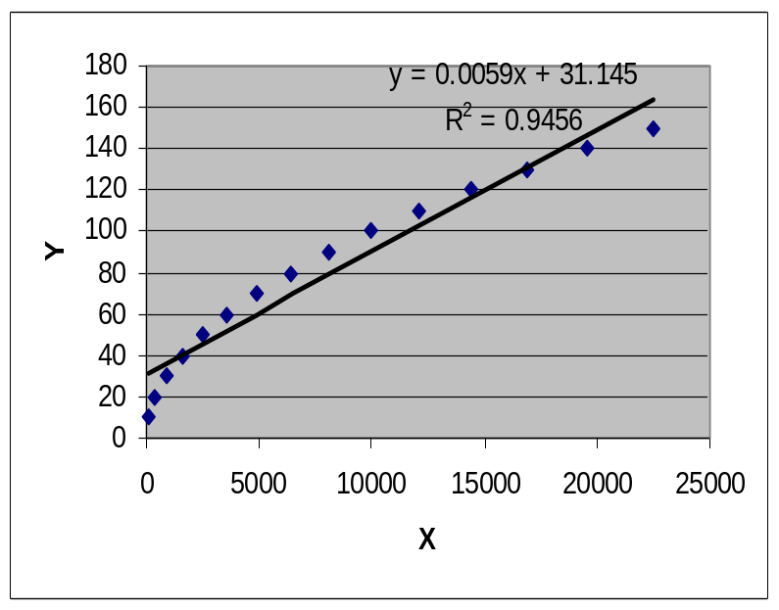
Assumptions
Continued
Linear regression
X and Y are normally distributed
The relationship between X and Y is linear and not curved
<number> | Presentation Title | Presenter Name | Date | Subject | Business Use Only

Slide 85
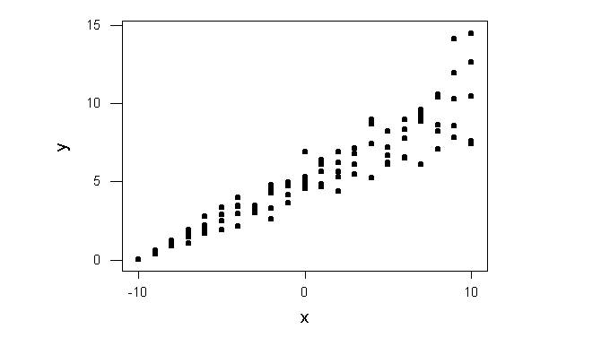
Assumptions
Continued
Linear regression
X and Y are normally distributed
The relationship between X and Y is linear and not curved
The variation of Y at particular values of X is not proportional to X
<number> | Presentation Title | Presenter Name | Date | Subject | Business Use Only

Slide 86
Assumptions
Continued
Linear regression
X and Y are normally distributed
The relationship between X and Y is linear and not curved
The variation of Y at particular values of X is not proportional to X
There is negligible error in measurement of X
<number> | Presentation Title | Presenter Name | Date | Subject | Business Use Only

Slide 87

Residual Analysis: check assumptions
Linear regression
The residual for observation i, e_{i}, is the difference between its observed and predicted value
Check the assumptions of regression by examining the residuals
  Examine for linearity assumption
  Examine for constant variance for all levels of X (homoscedasticity)
  Evaluate normal distribution assumption
  Evaluate independence assumption
Graphical Analysis of Residuals
  Can plot residuals vs. X
<number> | Presentation Title | Presenter Name | Date | Subject | Business Use Only

Slide 88

Residual Analysis for Linearity
Linear regression
Y
Y
x
x
residuals
x
x
residuals
Not Linear
✓
Linear
<number> | Presentation Title | Presenter Name | Date | Subject | Business Use Only
Slide from: Statistics for Managers Using Microsoft® Excel 4th Edition, 2004 Prentice-Hall

Slide 89

Residual Analysis for Homoscedasticity
Linear regression
Y
Y
x
x
residuals
x
x
residuals
✓
Non-constant variance
Constant variance
<number> | Presentation Title | Presenter Name | Date | Subject | Business Use Only
Slide from: Statistics for Managers Using Microsoft® Excel 4th Edition, 2004 Prentice-Hall

Slide 90

Linear regression
Residual Analysis for Independence
Not Independent
✓
Independent
residuals
X
residuals
X
residuals
X
<number> | Presentation Title | Presenter Name | Date | Subject | Business Use Only
Slide from: Statistics for Managers Using Microsoft® Excel 4th Edition, 2004 Prentice-Hall

Slide 91
The Use of Simple Regression
Linear regression
Answering Research Questions and Testing Hypothesis
Making Prediction about Some Outcome or Dependent Variable
Assessing an Instrument Reliability
Assessing an Instrument Validity
<number> | Presentation Title | Presenter Name | Date | Subject | Business Use Only

Slide 92

The “F-test”
F-test
Is the difference in the means of the groups more
than background noise (=variability within groups)?
Summarizes the mean differences between all groups at once.
Analogous to pooled variance from a ttest.
<number> | Presentation Title | Presenter Name | Date | Subject | Business Use Only

Slide 93


The F-distribution
F-test
A ratio of variances follows an F-distribution:
The F-test tests the hypothesis that two variances are equal.
F will be close to 1 if sample variances are equal.
<number> | Presentation Title | Presenter Name | Date | Subject | Business Use Only

Slide 94
ANOVA example
F-test
Randomize 33 subjects to three groups: 800 mg calcium supplement vs. 1500 mg calcium supplement vs. placebo.
Compare the spine bone density of all 3 groups after 1 year.
<number> | Presentation Title | Presenter Name | Date | Subject | Business Use Only

Slide 95
F-test
Spine bone density vs. treatment
N=11 = 11 = 11
Mean= 0.92 = 0.94 = 1.06
SD= 0.10 = 0.08 = 0.11
1.2
1.1
Within group variability
Between group variation
1.0
S
P
Within group variability
I
N
E
Within group variability
0.9
0.8
0.7
<number> | Presentation Title | Presenter Name | Date | Subject | Business Use Only
PLACEBO
800mg CALCIUM
1500 mg CALCIUM

Slide 96
Group means and standard deviations
F-test
Placebo group (n=11):
  Mean spine BMD = .92 g/cm²
  standard deviation = .10 g/cm²
800 mg calcium supplement group (n=11)
  Mean spine BMD = .94 g/cm²
  standard deviation = .08 g/cm²
1500 mg calcium supplement group (n=11)
  Mean spine BMD =1.06 g/cm²
  standard deviation = .11 g/cm²
<number> | Presentation Title | Presenter Name | Date | Subject | Business Use Only

Slide 97



The F-Test
F-test
The difference of each group’s mean from the overall mean.
Between-group variation.
The size of the groups.
Large F value indicates that the between group variation exceeds the within group variation (=the background noise).
The average amount of variation within groups.
Each group’s variance.
<number> | Presentation Title | Presenter Name | Date | Subject | Business Use Only

Slide 98

t-test
History
T-test
The t-statistic was introduced in 1908 by William Sealy Gosset, a chemist working for the Guinness brewery in Dublin, Ireland
He published the test in Biometrika in 1908, but was forced to use a pen name by his employer, who regarded the fact that they were using statistics as a trade secret.
"Small samples are slippery customers whose word is not to be taken as gospel" (Moroney).
William Sealy Gosset (June 13, 1876–October 16, 1937)
<number> | Presentation Title | Presenter Name | Date | Subject | Business Use Only

Slide 99

t-test tests: whether the means of two groups are statistically different from each other
T-test
The first thing to notice about the three situations is that the difference between the means is the same in all three
1st case: moderate variability
2nd case: high variability case
3rd case: low variability
Clearly, we would conclude that the two groups appear most different or distinct in the bottom or low-variability case. Why?
Because there is relatively little overlap between the two bell-shaped curves. In the high variability case, the group difference appears least striking because the two bell-shaped distributions overlap so much.
Mean1 Mean2
To find the differences between scores for two groups:
judge the difference between their means relative to the spread or variability of their scores.
<number> | Presentation Title | Presenter Name | Date | Subject | Business Use Only

Slide 100


t-test formula
T-test
Signal = the difference between the means is the signal that, in this case, we think our program or treatment introduced into the data;
Noise = a measure of variability that may make it harder to see the group difference
Signal = t-value ➔ 2 groups are different
Noise
One sample t-test
Two sample t-test
  Equal sample sizes and equal variance
  Unequal sample sizes and equal variance
  Unequal sample sizes and unequal variance
Paired t-test
<number> | Presentation Title | Presenter Name | Date | Subject | Business Use Only

Slide 101
t-test
Example: Paired test
T-test
Patient | Before Rx | After Rx | Diff = After - Before
#1 | 130 | 128 | -2
#2 | 102 | 100 | -2
#3 | 154 | 155 | 1
#4 | 113 | 110 | -3
#5 | 139 | 140 | 1
#6 | 125 | 120 | -5
#7 | 156 | 155 | -1
#8 | 108 | 105 | -3
#9 | 161 | 160 | -1
#10 | 105 | 107 | 2
Before Rx and After Rx data for 10 patients, are these measurements same or different ?
<number> | Presentation Title | Presenter Name | Date | Subject | Business Use Only

Slide 102
t-test
Example: 2 sample test
T-test
Patient | Group 1 | Group 2
#1 | 100 | 105
#2 | 86 | 95
#3 | 112 | 120
#4 | 80 | 85
#5 | 115 | 110
#6 | 83 | 100
#7 | 90 | 115
#8 | 94 | 93
#9 | 85 | 107
#10 | 105 | 120
Before Rx and After Rx data for 10 patients, are these measurements same or different ?
<number> | Presentation Title | Presenter Name | Date | Subject | Business Use Only

Slide 103
Determine Degrees of Freedom
T-test
Degrees of freedom, df, is value indicating the number of independent pieces of information a sample can provide for purposes of statistical inference.
Df = Sample size – Number of parameters estimated
Df for paired t-test is n minus 1
<number> | Presentation Title | Presenter Name | Date | Subject | Business Use Only

Slide 104
One-Factor
Analysis of Variance
ANOVA
A method to compare two or more (normal) population means

Slide 105
Does distance it takes to stop car at 60 mph depend on tire brand?
ANOVA
Brand1 Brand2 Brand3 Brand4 Brand5
194 189 185 183 195
184 204 183 193 197
189 190 186 184 194
189 190 183 186 202
188 189 179 194 200
186 207 191 199 211
195 203 188 196 203
186 193 196 188 206
183 181 189 193 202
188 206 194 196 195
<number> | Presentation Title | Presenter Name | Date | Subject | Business Use Only

Slide 106

Comparison of five tire brands
(stopping distance at 60 mph)
ANOVA
<number> | Presentation Title | Presenter Name | Date | Subject | Business Use Only

Slide 107
Sample descriptive statistics
ANOVA
Brand N MEAN SD
1 10 188.20 3.88
2 10 195.20 9.02
3 10 187.40 5.27
4 10 191.20 5.55
5 10 200.50 5.44
<number> | Presentation Title | Presenter Name | Date | Subject | Business Use Only

Slide 108
Hypotheses
ANOVA
The null hypothesis is that the group population means are all the same. That is:
  H₀: μ₁ = μ₂ = μ₃ = μ₄ = μ₅
The alternative hypothesis is that at least one group population mean differs from the others. That is:
  H_{A}: at least one μ_{i} differs from the others
<number> | Presentation Title | Presenter Name | Date | Subject | Business Use Only

Slide 109
Analysis of Variance
ANOVA
Analysis of Variance
for comparing all 5 brands
Source DF SS MS F P
Brand 4 1174.8 293.7 7.95 0.000
Error 45 1661.7 36.9
Total 49 2836.5
The P-value is small (0.000, to three decimal places), so reject the null hypothesis. There is sufficient evidence to conclude that at least one brand is different from the others.
<number> | Presentation Title | Presenter Name | Date | Subject | Business Use Only

Slide 110
Does learning method affect student’s exam scores?
ANOVA
Consider 3 methods:
  standard
  osmosis
  shock therapy
Convince 15 students to take part. Assign 5 students randomly to each method.
Wait eight weeks. Then, test students to get exam scores.
<number> | Presentation Title | Presenter Name | Date | Subject | Business Use Only

Slide 111

Suppose … Study #1
ANOVA
Is there a reasonable conclusion?
<number> | Presentation Title | Presenter Name | Date | Subject | Business Use Only

Slide 112

Suppose … Study #2
ANOVA
Is there a reasonable conclusion?
<number> | Presentation Title | Presenter Name | Date | Subject | Business Use Only

Slide 113

Suppose … Study #3
ANOVA
Is there a reasonable conclusion?
<number> | Presentation Title | Presenter Name | Date | Subject | Business Use Only

Slide 114

“Analysis of Variance”
ANOVA
The variation between the group means and the grand mean is larger than the variation within the groups.
<number> | Presentation Title | Presenter Name | Date | Subject | Business Use Only

Slide 115

“Analysis of Variance”
ANOVA
The variation between the group means and the grand mean is smaller than the variation within the groups.
<number> | Presentation Title | Presenter Name | Date | Subject | Business Use Only

Slide 116
Analysis of Variance
ANOVA
A division of the overall variability in data values in order to compare means.
Overall (or “total”) variability is divided into two components:
  the variability “between” groups, and
  the variability “within” groups
Summarized in an “ANOVA” table.
<number> | Presentation Title | Presenter Name | Date | Subject | Business Use Only

Slide 117
ANOVA Table for Study #1
ANOVA
“F” means “F test statistic”
One-way Analysis of Variance
Source DF SS MS F P
Factor 2 2628.4 1314.2 92.98 0.000
Error 12 169.6 14.1
Total 14 2798
P-Value
“Source” means “the source of the variation in the data”
“DF” means “the degrees of freedom”
“SS” means “the sum of squares”
“MS” means “mean sum of squares”
<number> | Presentation Title | Presenter Name | Date | Subject | Business Use Only

Slide 118
ANOVA Table for Study #1
ANOVA
One-way Analysis of Variance
Source DF SS MS F P
Factor 2 2628.4 1314.2 92.98 0.000
Error 12 169.6 14.1
Total 14 2798
“Factor” means “Variability between groups” or “Variability due to the factor (or treatment) of interest”
“Error” means “Variability within groups” or “unexplained random error”
“Total” means “Total variation from the grand mean”
<number> | Presentation Title | Presenter Name | Date | Subject | Business Use Only

Slide 119














ANOVA Notation
ANOVA
Group | Data |  |  |  | Means
1
2
m
 |  | Grand Mean
<number> | Presentation Title | Presenter Name | Date | Subject | Business Use Only

Slide 120
General ANOVA Table
ANOVA
One-way Analysis of Variance
Source DF SS MS F P
Factor m-1 SS(Between) MSB MSB/MSE
Error n-m SS(Error) MSE
Total n-1 SS(Total)
From F-distribution with m-1 numerator and n-m denominator d.f.
MSB = SS(Between)/(m-1)
MSE = SS(Error)/(n-m)
n-1 = (m-1) + (n-m)
SS(Total) = SS(Between) + SS(Error)
<number> | Presentation Title | Presenter Name | Date | Subject | Business Use Only

Slide 121
ANOVA Table for Study #1
ANOVA
One-way Analysis of Variance
Source DF SS MS F P
Factor 2 2628.4 1314.2 92.98 0.000
Error 12 169.6 14.1
Total 14 2798
1314.2 = 2628.4/2
14.1 = 169.6/12
14 = 2 + 12
92.98 = 1314.2/14.1
2798 = 2628.4 + 169.6
<number> | Presentation Title | Presenter Name | Date | Subject | Business Use Only

Slide 122




Total sum of squares SS(TO)
ANOVA
Definition:
Shortcut:
<number> | Presentation Title | Presenter Name | Date | Subject | Business Use Only

Slide 123




Treatment sum of squares SS(T)
ANOVA
Definition:
Shortcut:
<number> | Presentation Title | Presenter Name | Date | Subject | Business Use Only

Slide 124


Error sum of squares SS(E)
ANOVA
Definition:
Shortcut:
<number> | Presentation Title | Presenter Name | Date | Subject | Business Use Only

Slide 125



SS(TO) = SS(T) + SS(E)
ANOVA
We’ve broken down the TOTAL variation into a component due to TREATMENT and a component due to random ERROR.
<number> | Presentation Title | Presenter Name | Date | Subject | Business Use Only

Slide 126
Recall Study #3
ANOVA
<number> | Presentation Title | Presenter Name | Date | Subject | Business Use Only

Slide 127
ANOVA Table for Study #3
ANOVA
One-way Analysis of Variance
Source DF SS MS F P
Factor 2 80.1 40.1 0.46 0.643
Error 12 1050.8 87.6
Total 14 1130.9
The P-value is large so we cannot reject the null hypothesis. There is insufficient evidence to conclude that the average exam scores differ for the three learning methods.
<number> | Presentation Title | Presenter Name | Date | Subject | Business Use Only

Slide 128

Do Holocaust survivors have more sleep problems than others?
ANOVA
<number> | Presentation Title | Presenter Name | Date | Subject | Business Use Only

Slide 129
ANOVA Table for Sleep Study
ANOVA
One-way Analysis of Variance
Source DF SS MS F P
Factor 2 1723.8 861.9 61.69 0.000
Error 117 1634.8 14.0
Total 119 3358.6
<number> | Presentation Title | Presenter Name | Date | Subject | Business Use Only

Slide 130
Types of variables to be analyzed
Statistical procedure
or measure of association
Predictor variable/s
Outcome variable
Cross-sectional/case-control studies
Binary (two groups)
Continuous
T-test
Binary
Ranks/ordinal
Wilcoxon rank-sum test
Categorical (>2 groups)
Continuous
ANOVA
Continuous
Continuous
Simple linear regression
Multivariate
(categorical and continuous)
Continuous
Multiple linear regression
Categorical
Categorical
Chi-square test (or Fisher’s exact)
Binary
Binary
Odds ratio, risk ratio
Multivariate
Binary
Logistic regression
Cohort Studies/Clinical Trials
Binary
Binary
Risk ratio
Categorical
Time-to-event
Kaplan-Meier/ log-rank test
Multivariate
Time-to-event
Cox-proportional hazards regression, hazard ratio
Categorical
Continuous
Repeated measures ANOVA
<number> | Presentation Title | Presenter Name | Date | Subject | Business Use Only
Multivariate
Continuous
Mixed models; GEE modeling

Slide 131
Alternative summary: statistics for various types of outcome data
Outcome Variable | Are the observations independent or correlated? |  | Assumptions
 | Independent | Correlated
Continuous (e.g. pain scale, cognitive function) | Ttest ANOVA Linear correlation Linear regression | Paired ttest Repeated-measures ANOVA Mixed models/GEE modeling | Outcome is normally distributed (important for small samples). Outcome and predictor have a linear relationship.
Binary or categorical (e.g. fracture yes/no) | Difference in proportions Relative risks Chi-square test Logistic regression | McNemar’s test Conditional logistic regression GEE modeling | Chi-square test assumes sufficient numbers in each cell (>=5)
Time-to-event (e.g. time to fracture) | Kaplan-Meier statistics Cox regression | n/a | Cox regression assumes proportional hazards between groups
<number> | Presentation Title | Presenter Name | Date | Subject | Business Use Only

Slide 132
Continuous outcome (means)
Outcome Variable | Are the observations independent or correlated? |  | Alternatives if the normality assumption is violated (and small sample size):
 | independent | correlated
Continuous (e.g. pain scale, cognitive function) | Ttest: compares means between two independent groups ANOVA: compares means between more than two independent groups Pearson’s correlation coefficient (linear correlation): shows linear correlation between two continuous variables Linear regression: multivariate regression technique used when the outcome is continuous; gives slopes | Paired ttest: compares means between two related groups (e.g., the same subjects before and after) Repeated-measures ANOVA: compares changes over time in the means of two or more groups (repeated measurements) Mixed models/GEE modeling: multivariate regression techniques to compare changes over time between two or more groups; gives rate of change over time | Non-parametric statistics Wilcoxon sign-rank test: non-parametric alternative to the paired ttest Wilcoxon sum-rank test (=Mann-Whitney U test): non-parametric alternative to the ttest Kruskal-Wallis test: non-parametric alternative to ANOVA Spearman rank correlation coefficient: non-parametric alternative to Pearson’s correlation coefficient
<number> | Presentation Title | Presenter Name | Date | Subject | Business Use Only

Slide 133
Binary or categorical outcomes (proportions)
Outcome Variable | Are the observations independent or correlated? |  | Alternative to the chi-square test if sparse cells:
 | independent | correlated
Binary or categorical (e.g. fracture yes/no) | Difference in proportions: compares proportions between two independent groups Relative risks: odds ratios or risk ratios Chi-square test: compares proportions between more than two groups Logistic regression: multivariate technique used when outcome is binary; gives multivariate-adjusted odds ratios | McNemar’s test: compares binary outcome between correlated groups (e.g., before and after) Conditional logistic regression: multivariate regression technique for a binary outcome when groups are correlated (e.g., matched data) GEE modeling: multivariate regression technique for a binary outcome when groups are correlated (e.g., repeated measures) | Fisher’s exact test: compares proportions between groups when there are sparse data (some cells <5).
<number> | Presentation Title | Presenter Name | Date | Subject | Business Use Only

Slide 134
References
Daniel Oppenheimer, Stanford University
2) Heibatollah Baghi, and Mastee Badii, George Mason University
3) Basic Business Statistics: Concepts & Applications
4) Penn State University
5) Henri D. Grissino-Mayer, University of Tennessee
<number> | Presentation Title | Presenter Name | Date | Subject | Business Use Only

